Slide 1
Managing Object Creation
IN710 OOSD 2014
Session 5.1
Notes:
Demo game first

Slide 2
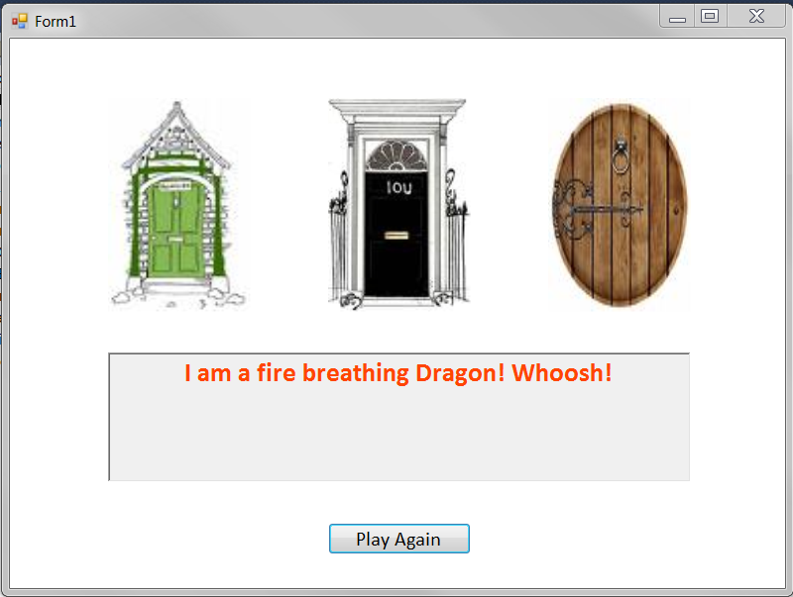
The Mystery Door Game
Notes:
This is a simple game
There are four kinds of characters – vampires, witches, dragons and golden geese
Game characters hold a string called ‘message’ to tell who they are. For example, witches say ‘I am a witch’
They each have a text colour that they print their text message in (we use a richTextBox control for this).
There is a gameEngine class that holds a collection of characters
There is a Form class that provides the front end
Characters are randomly allocated to doors (duplication is permitted).
The player clicks on a door, and the character behind it is revealed by the contents of the rtb.
The goal is to get the Goose.
We are going to look at the very simple code of this very simple game closely
We will be able to see a common sort of problem, and then learn the design pattern to fix it
We will start with the game characters

Slide 3
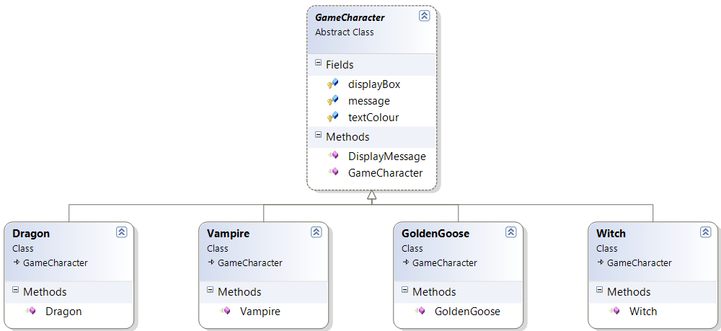
The Mystery Door Game
Notes:
So here is the game character class hierarchy...
In reality these classes are so simple we might not make this architecture, we’d just set the message string and text colour and get on with it. But we make these separate classes on the assumption that in a real game the characters would be complex things with some common data and methods and some need for polymorphism, as we have often seen.

Slide 4
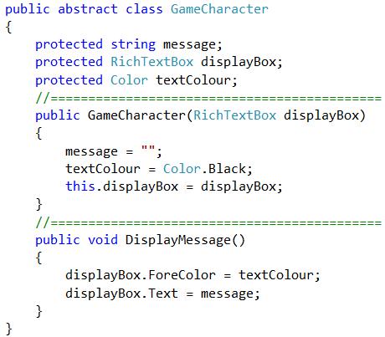
The Mystery Door Game
Notes:
Here is the base class
Returning a string isn’t enough here because of the coloured text, so we are giving the object access to its display control.
The alternative (requiring the form to request the colour and change the rtb) is obviously too coupled.
We see the importance of using the right technique for the computational situation.

Slide 5
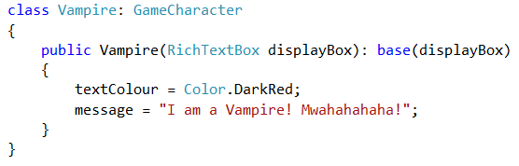
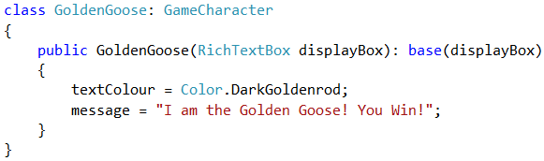
The Mystery Door Game
Notes:
And here are two of the concrete child classes
They inherit their required behaviour, so they only need to set up their class-specific data values in a constructor.
The others you can figure out

Slide 6
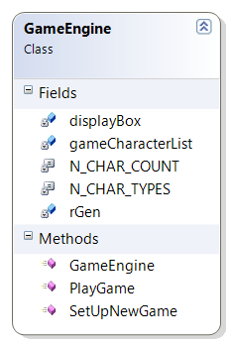
The Mystery Door Game
Notes:
Here is GameEngine
Its list of characters
A constant to tell it how many character types it can choose from and how many it needs (the number of doors)
A richTextBox to pass into the characters when he creates them
A random generator
Methods: constructor, game setup and game play

Slide 7
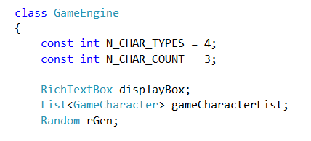
GameEngine Fields
Notes:
The start of the class, showing the class data fields

Slide 8
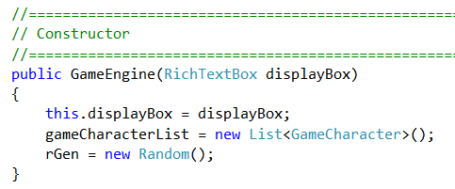
Game Engine Methods
Notes:
Constructor

Slide 9
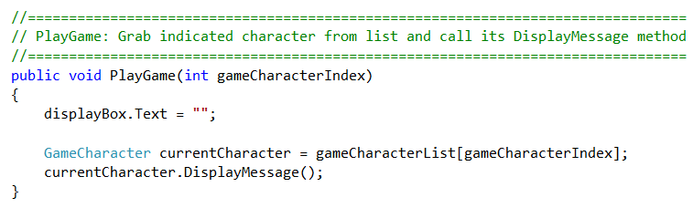
Game Engine Methods
Notes:
The PlayGame method…
The Form (actually the pictureBox onclick handler) will pass in the index.
Grab it and call that character’s DisplayMessage(), which handles the coloured writing.
Let’s just see what that looks like in the Form….

Slide 10
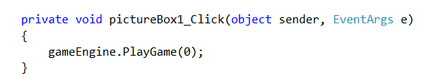
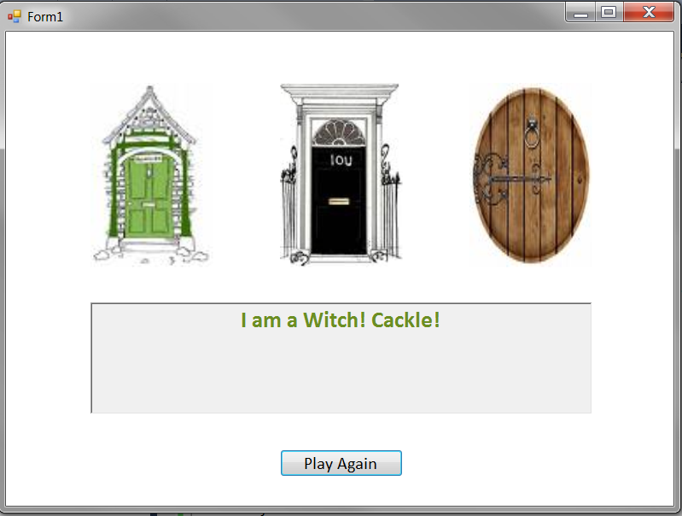
The Mystery Door Game
Notes:
So if you click on door1 (pictureBox1) this is the code that is executed.
If there is a witch behind door 1, (in the first position of the GameEngine’s character list), you see this.
All good so far?
So let’s look now carefully at the method where the problem arises.
This is the setUpGame method of GameEngine
It is called in Form_Load to start things, and it is called every time someone clicks the new game button

Slide 11
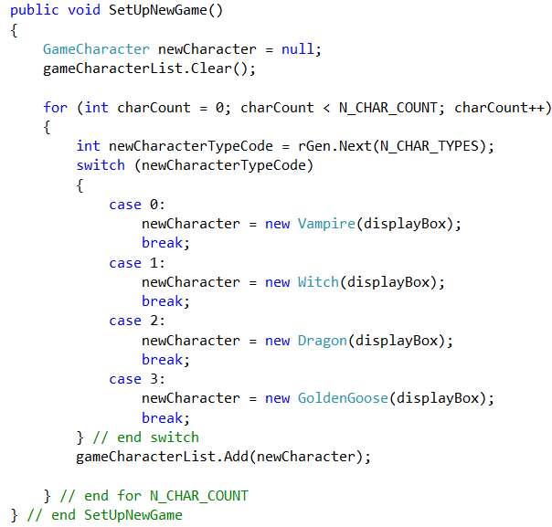
The Mystery Door Game
Notes:
But here is the method we are really interested in.
This method belongs to the GameEngine class
This is the method called to set up a new game
The main work here is to create new characters and add them to the list, for playGame() to use.
For each door, it generates a random number, then uses that to decide what kind of game character to put behind the door. (The version where there is always a goose would be the same, you’d just put the goose in first, choose n-1 others and then shuffle the list.)
Given the OOAD principles we have been going on and on about so far, what is wrong with this code?
If you can’t see it, consider what would happen if we decided to add a new kind of game character, say a Unicorn.
What does the Open/Closed principle tell us here – we have to touch existing code (specifically, the switch statement). Bad.
What about coupling? Changes to the GameCharacter class hierarchy requires changes to a GameEngine method. Bad
.
And in a real game, think about how many different points in the main game code you might need to create a new game character. Will you have a switch statement at every one of them? Will you modify all of them when you add a new character? Ew?
How can we modify our implementation so that we can freely add new game characters and not have to touch the Game class?

Slide 12
Useful Rule
“Encapsulate what varies”
In our game, one thing that might change is the production of game characters.
Game
coupled ☹
uses
Character Factory
creates
Game Characters
Notes:
This is a good guide for OO.
We want to be graceful under change
If we can identify the things that will change and encapsulate them, we can localise the impact.
We can protect other elements
In our game, what can change is the choice and production of game characters. So that is what we want to encapsulate
And what is the OO way to encapsulate something?
Make it a class
This kind of class is called a ‘factory’.
Its sole responsibility is to produce objects according to some rule, and return them
It’s kind of like a constructor machine.
Let’s look at the code for the character factory...

Slide 13
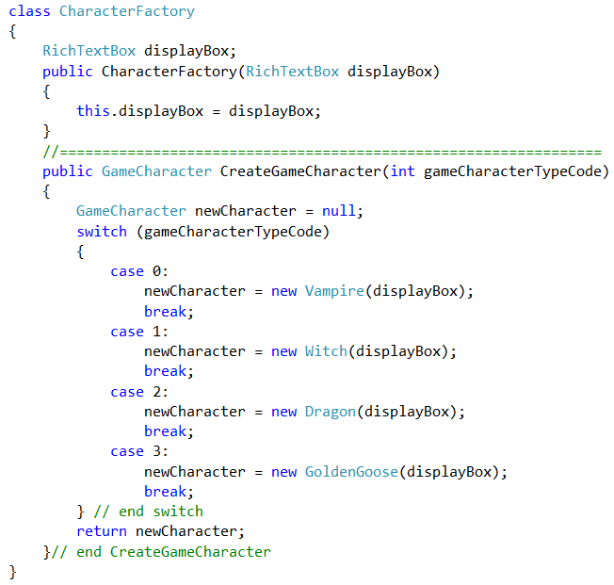
CharacterFactory
Notes:
It only has one method....(plus the constructor, where the rtb is passed in)
We have taken the code that is sensitive to change (the switch statement used to create a new character) and we have removed it from GameEngine and placed it in its own class
So what happens to GameEngine.SetUpGame()……?

Slide 14
Old GameEngine Code
Notes:
Before…

Slide 15
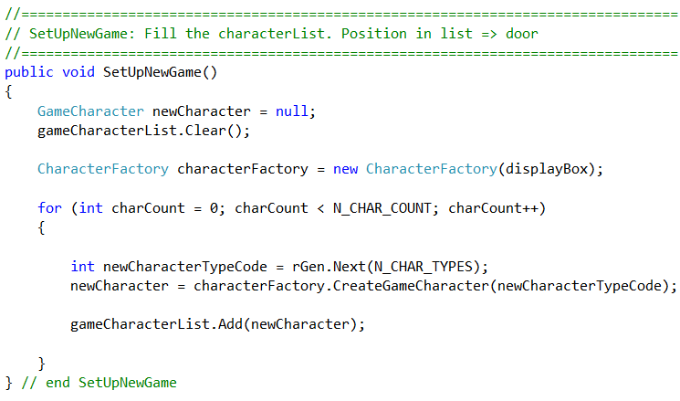
New GameEngine Code
Notes:
GameEngine code now..
Note that we could have created the factory in the constructor.
I just put it here so you could see it being created...
Now isn’t this nice code?
What happens to GameEngine if you need to add unicorns? NOTHING
Only the factory class changes. (And the constants, but that’s not really architectural.)
In fact, the GameEngine doesn’t know anything about the actual product it uses.
If you wanted to change the game so that there were bunny rabbits, or space alien vehicles or quotes from Shakespeare behind the doors, it wouldn’t make any difference at all. ⬅ Yay!!!

Slide 16
Question that’s Bothering You
“But aren’t the GameCharacter classes and the CharacterFactory class coupled?”
Notes:
Isn’t the factory now violating the Open/Closed principle?
The answer is yes.
But it is basically the GameFactory’s job (SRP) to be coupled to the GameCharacter hierarchy.
As opposed to the GameEngine class, who has a different responsibility (managing the game data and logic).
The CharacterFactory encapsulates the necessary coupling, isolating GameEngine from it.
You won’t break other functionality in CharacterFactory, because there isn’t any.
And the coupling is localised to one place in the system, not spread around to every location that you need to create a character.

Slide 17
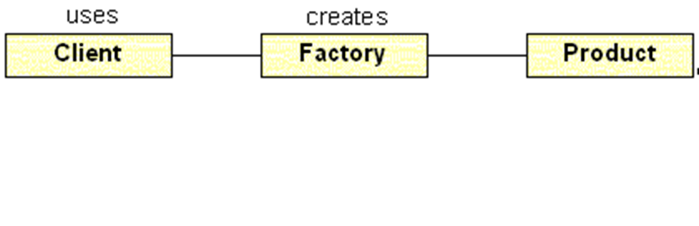
The Simple Factory
“Decoupling object use and creation by delegating the creation process to a dedicated class.”
Notes:
The technique we have just seen is called the simple factory pattern
If you ever have a class method that contains logic to create one of a number of other class instances, you should consider encapsulating that logic into its own class (a Factory).
Then, instead of peppering that logic all over the place in the consumer class, it resides only in the Factory, and the consumer class simply talks to the Factory object as needed.
Although quite useful, it is not one of the official 23 GoF patterns.
The GoF contains a number of more complex factory-based patterns, and we will see the most important one next.

Slide 18
Complex Factories
Sometimes, the object creation behaviour you want to encapsulate is more complex.
Base Class: Generates some object (common behaviour)
Child Class 1: needs concrete object 1
Child Class 2 needs concrete object 2
Child Class n: needs concrete object n
……..
Notes:
In the Mystery Door, we had one class (GameEngine) who needed to create instances from a set of objects.
But in some situations, the creation logic can be more complex.
For example, you might have a class hierarchy. Each child needs to generate some objects for some common behaviour, but the actual concrete objects needed differs from child to child.
Concrete objects 1,2,…n will probably be related in some way (perhaps all members of their own inheritance hierarchy, or implementing a common interface), but each is a different concrete class.
This diagram shows the situation with the family needing only one object, but you can see how it could be extended to many different objects that needed to be created. That is: Child Class 1 needs to create objects from Set 1, Child class 2 needs to create objects from Set 2, etc.
How will we manage our factory behaviour now?
Let’s look at an example…

Slide 19
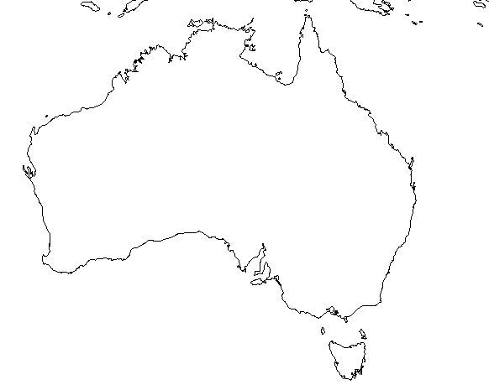
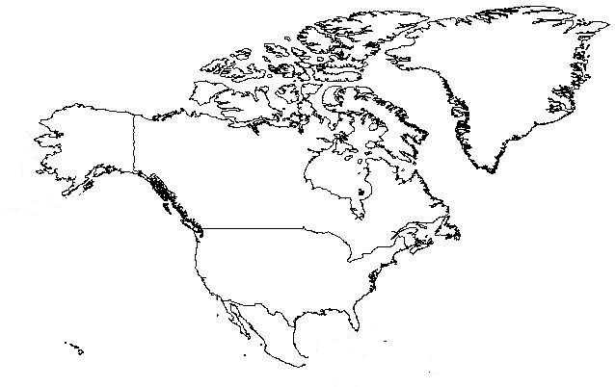
More Complex Factories
Notes:
Based on an example from dofactory.com
Let’s say that you are building some sort of zoological simulator of the type used in habitat management, or climate change prediction, or something.
For simplicity, we’ll show only North America and Australia, but of course, the architecture should scale elegantly to as many land masses as you want

Slide 20






More Complex Factories
Notes:
Each continent needs to simulate the appropriate flora and fauna.
For example, in Australia we need to create koalas, crocodiles and kangaroos
In North America, we need to create eagles, bison and wolves
The continents are likely to be descendants of a common base class
The animals are likely to be descendants of another common base class
Keeping in mind that the purpose of the Factory approach is to decouple object use from object creation, what architecture might we use here that would be clean and scalable?

Slide 21
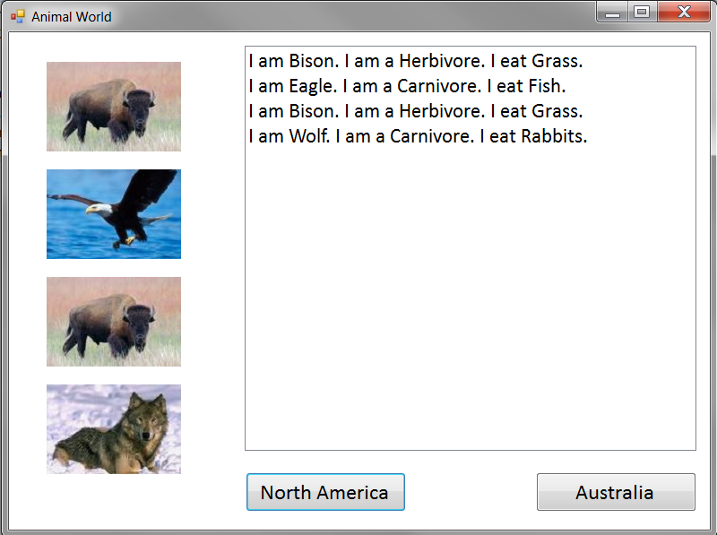
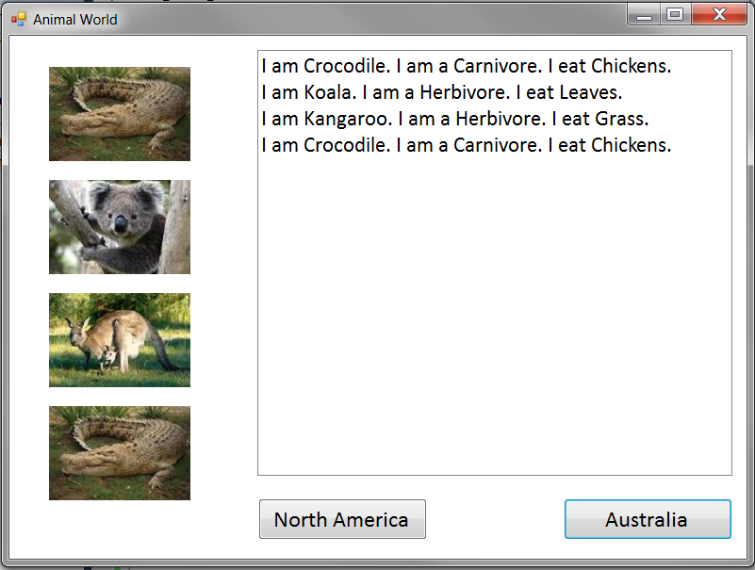
Animal World
Notes:
The actual program we will build is very, very simple in its behaviour
It basically just creates three randomly selected animals, then dumps their information out to a listbox and the canvas.
The architecture, of course, would be unchanged if you added more functionality, like reproduction, migration, predator-prey relationships, etc.
This screen shows two snapshots of a single application – one for the NA button and one for the Australia button

Slide 22
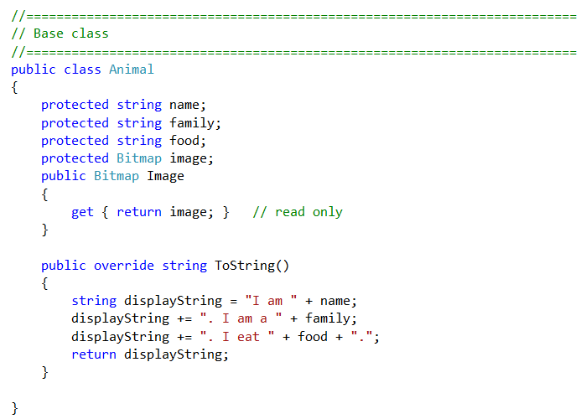
Animal World
Notes:
We’ll start with the Animal classes, because they are the simplest
For our very simple example, we might have something like this...
The base class…

Slide 23
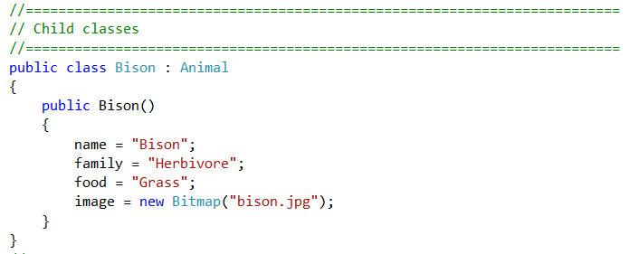
Animal World
Notes:
…and one of the animals.
The architecture works the same no matter how fancy you made the animals

Slide 24
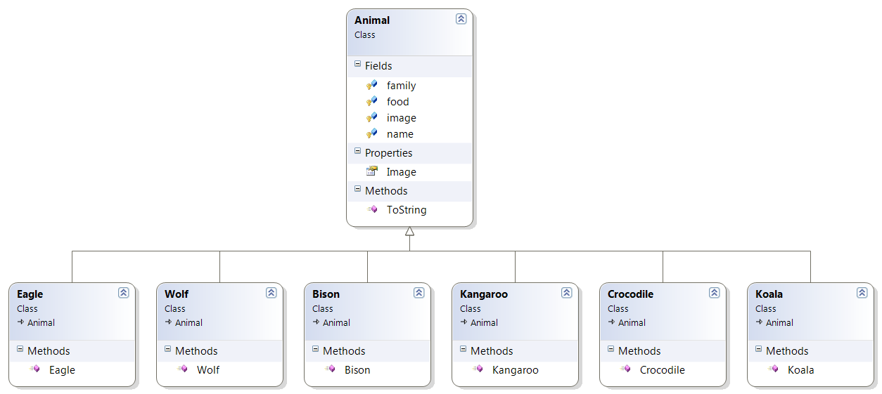
Animal World
Notes:
Put them all together into something like this
Again, in a real simulation you might have various subtrees going, but this will do for us, because all of our animals behave the same

Slide 25
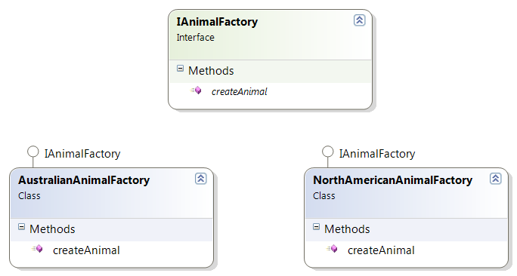
Animal World
Notes:
So the Factory hierarchy looks like this
You should see that it would be very straightforward to add additional factories for more continents

Slide 26
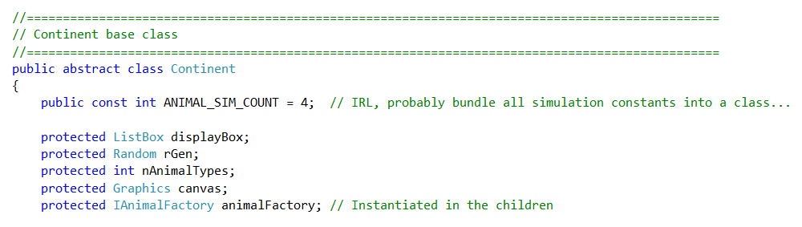
Continent Fields
Notes:
And finally, we consider the continents themselves.
They will be responsible for running the simulation, so they need the simulation parameters and controls for displaying.
They will also need a factory to use to create their animals.
Which factory do they get? The one that produces the kind of animals they need
When do they get their factory object? In their constructor

Slide 27
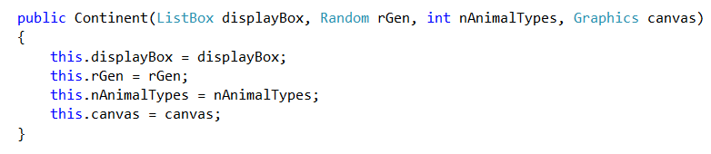
Continent Base Class Constructor

Slide 28
Animal World Factory
Form code
Notes:
Exercise in practical
One thing you will notice is that there is very little code in the form.
Basically you create your continents, and, in the appropriate button click handler, you tell a continent instance to execute its runsimulation method.
Again we see this very common pattern in OO of lots of code underneath, and by the time we get to the upper management, it’s just a simple method call.

Slide 29
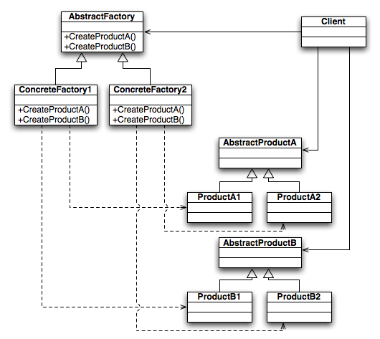
Abstract Factory Pattern
Notes:
The pattern we just made is an example of the “Abstract Factory Pattern”
You have an abstract factory (our interface), and appropriate concrete implementations of it
Here is the official diagram for the Abstract Factory Pattern.
These sorts of diagrams are often presented for the design patterns.
The solid lines are “needs” or “uses” (i.e. composition or aggregation).
The dotted lines are “creates”.
The hollow arrows are inheritance, like always.
So you have a Client that needs one or more products. (Here called Products A and B; there could of course be more.)
Instead of creating the products itself, it uses a factory, but it uses an abstract factory – in our example, an interface, but it can also work with an abstract base class – so that different versions of our client could have different concrete instantiations of the factory.
The client gets a concrete factory (a class that implements the interface or abstract base class) which creates concrete instances of the products that it needs.
For us, the client is the Continent child, the AbstractProducts are the Animals. That is “Continents need Animals”
They need the abstract factory AnimalFactory, which is instantiated as concrete version NorthAmericanAnimalFactory or AustralianAnimalFactory
Sometimes, reading the diagram is harder than writing the code…
In practical, we will build several examples using the Abstract Factory Pattern.

Slide 30
Factory Method Pattern
In the Factory Method Pattern, the factory behaviour is implemented not as an object, but simply as an abstract method in the consumer class
Notes:
There is another common factory pattern in the GoF, the factory method pattern
Used when there is only one kind of product being produced
This is the case for animal world, so it could be implemented this way, although we will do the full Abstract Factory Pattern, to get the experience of building one.
If you are interested, you can do this as an extra exercise.
So the switch statement actually becomes part of the Continent class code

Slide 31
Main Theoretical Point
Decoupling object creation from object use is a powerful technique that supports code flexibility and reuse.

Slide 32
Practical (finish before Friday’s class)
Implement the Animal World simulator as described in lecture.
To test your architecture:
After it is running, add a new animal to each continent.
Then add a new continent.
If you’ve done it right, these changes will require minimal modification, and that will only be to a single class, the one directly involved with the change.
Notes:
The ppt on the I: drive does not contain the code. Just copying the code won’t really teach you anything. Much better to work it our yourself.
Get this done before Friday.
We will see more of the factory pattern in class on Friday.

